Slide 1


Plug-ins and what not…
by Martin Chaov

Slide 2

Hi, I’m Martin!
Tech enthusiast
Software architect
Ex-designer
...at least for me...

Slide 3
Agenda
Intro to architecture
What is a plugin
A solution for plugins
Pros/Cons
Demo
Summary

Slide 4

Disclaimer
Notes:
React application vs Application using React as a view engine
I already have an application, and have 0 intentions to re-write it

Slide 5
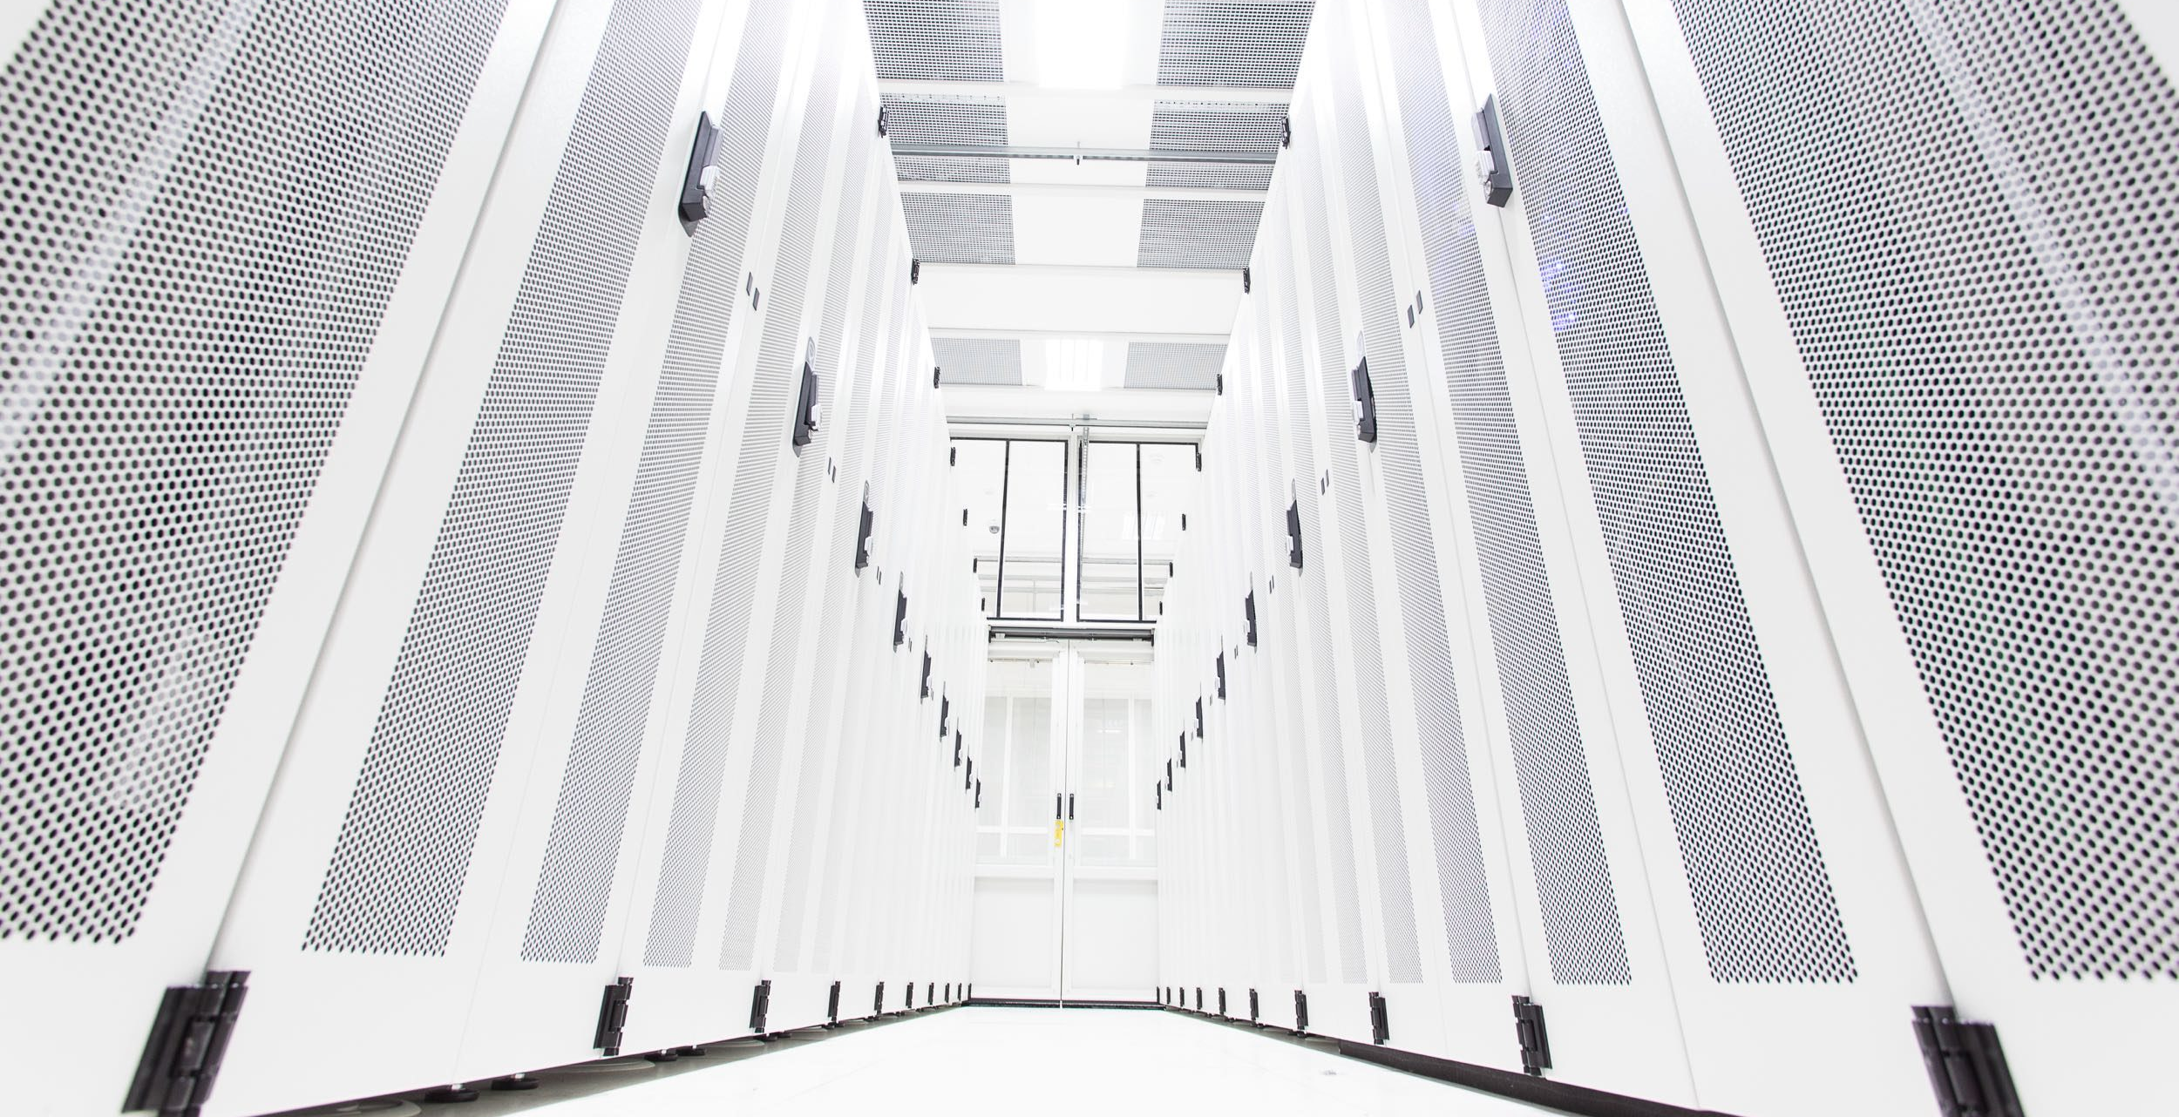
Intro to architecture
Fundamental structural choices
Costly to change
Focus on different qualities
Notes:
1. Software architecture is about making fundamental structural choices which are costly to change once implemented.
2. Qualities of an architecture
Performance – shows the response of the system to performing certain actions for a certain period of time.
Interoperability – is an attribute of the system or part of the system that is responsible for its operation and the transmission of data and its exchange with other external systems.
Usability – is one of the most important attributes, because, unlike in cases with other attributes, users can see directly how well this attribute of the system is worked out.
Reliability – is an attribute of the system responsible for the ability to continue to operate under predefined conditions.
Availability – is part of reliability and is expressed as the ratio of the available system time to the total working time.
Security – ability of the system to reduce the likelihood of malicious or accidental actions as well as the possibility of theft or loss of information.
Maintainability –ability of the system to support changes.
Modifiability – determines how many common changes need to be made to the system to make changes to each individual item.
Testability – how well the system allows performing tests, according to predefined criteria.
Scalability – handle load increases without decreasing performance, or the possibility to rapidly increase the load.
Reusability – chance of using a component or system in other components/systems with small or no change.
Supportability – useful information for identifying and solving problems.

Slide 6

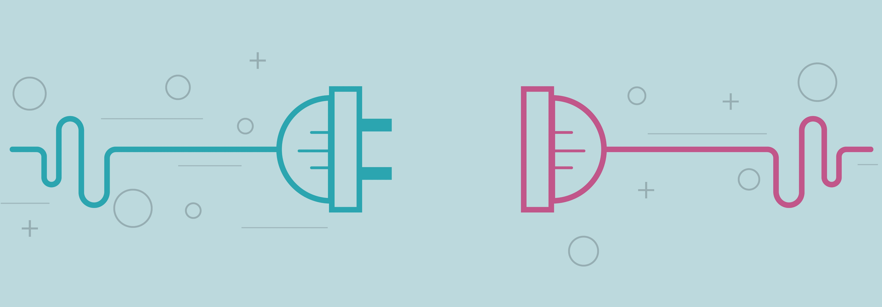
What is a Plug-in?
A piece of software - component
Extend or enhance existing functionality
Can not live on it’s own
Notes:
In computing, a plug-in is a software component that adds a specific feature to an existing computer program. When a program supports plug-ins, it enables customization.
Web browsers have historically allowed executables as plug-ins, though they are now mostly deprecated. (These are a different type of software module than browser extensions.) Two plug-in examples are the Adobe Flash Player for playing videos and a Java virtual machine for running applets.
A theme or skin is a preset package containing additional or changed graphical appearance details, achieved by the use of a graphical user interface (GUI) that can be applied to specific software and websites to suit the purpose, topic, or tastes of different users to customize the look and feel of a piece of computer software or an operating system front-end GUI (and window managers).

Slide 7
An interface
CEE 7/5 socket
CEE 7/6 plug (inc. CEE 7/7, 7/16 and 7/17 plugs)
230V AC
50 Hz

Slide 8
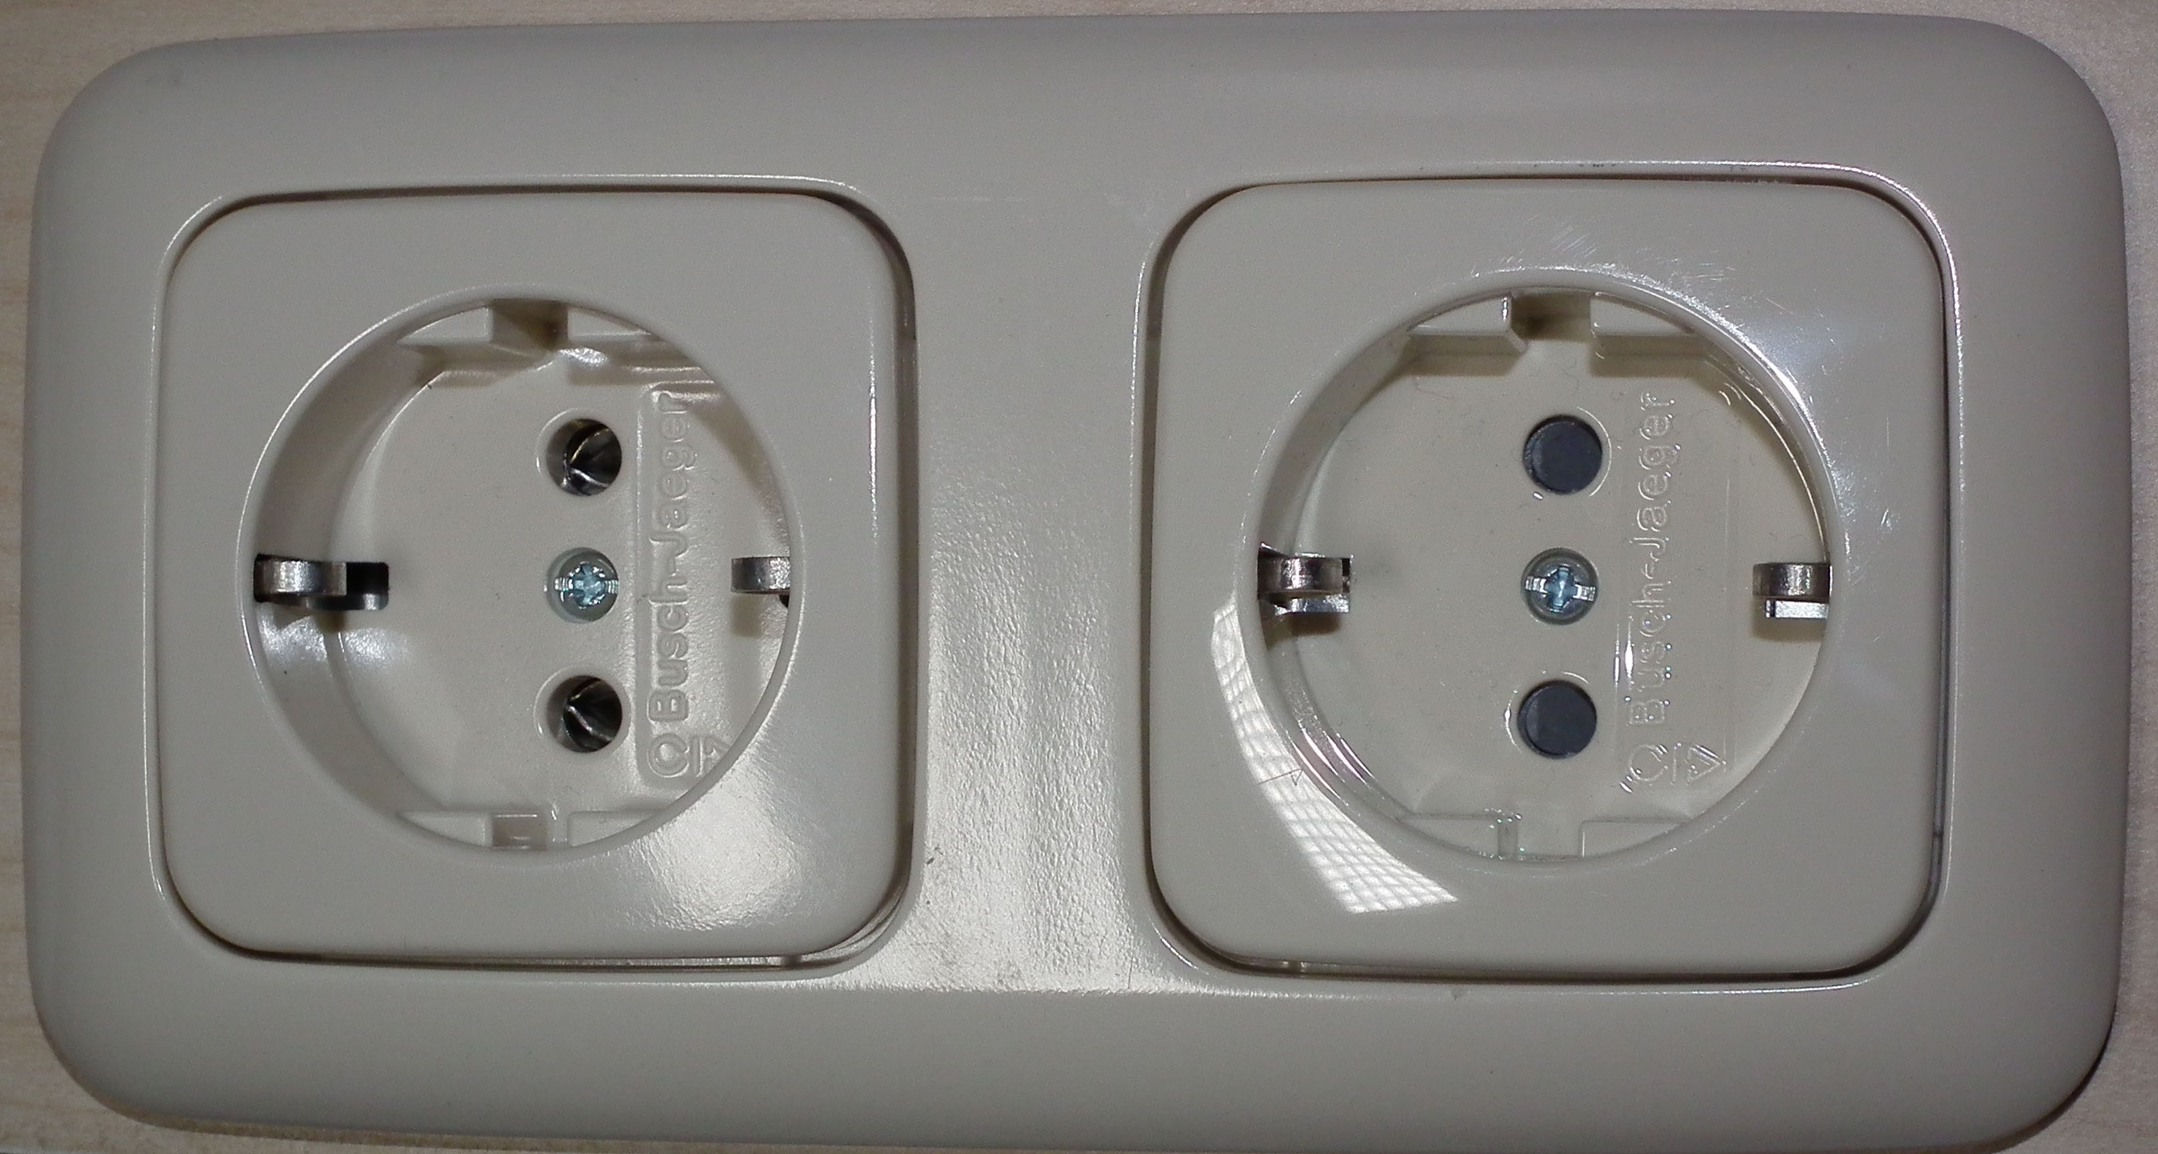

Slide 9
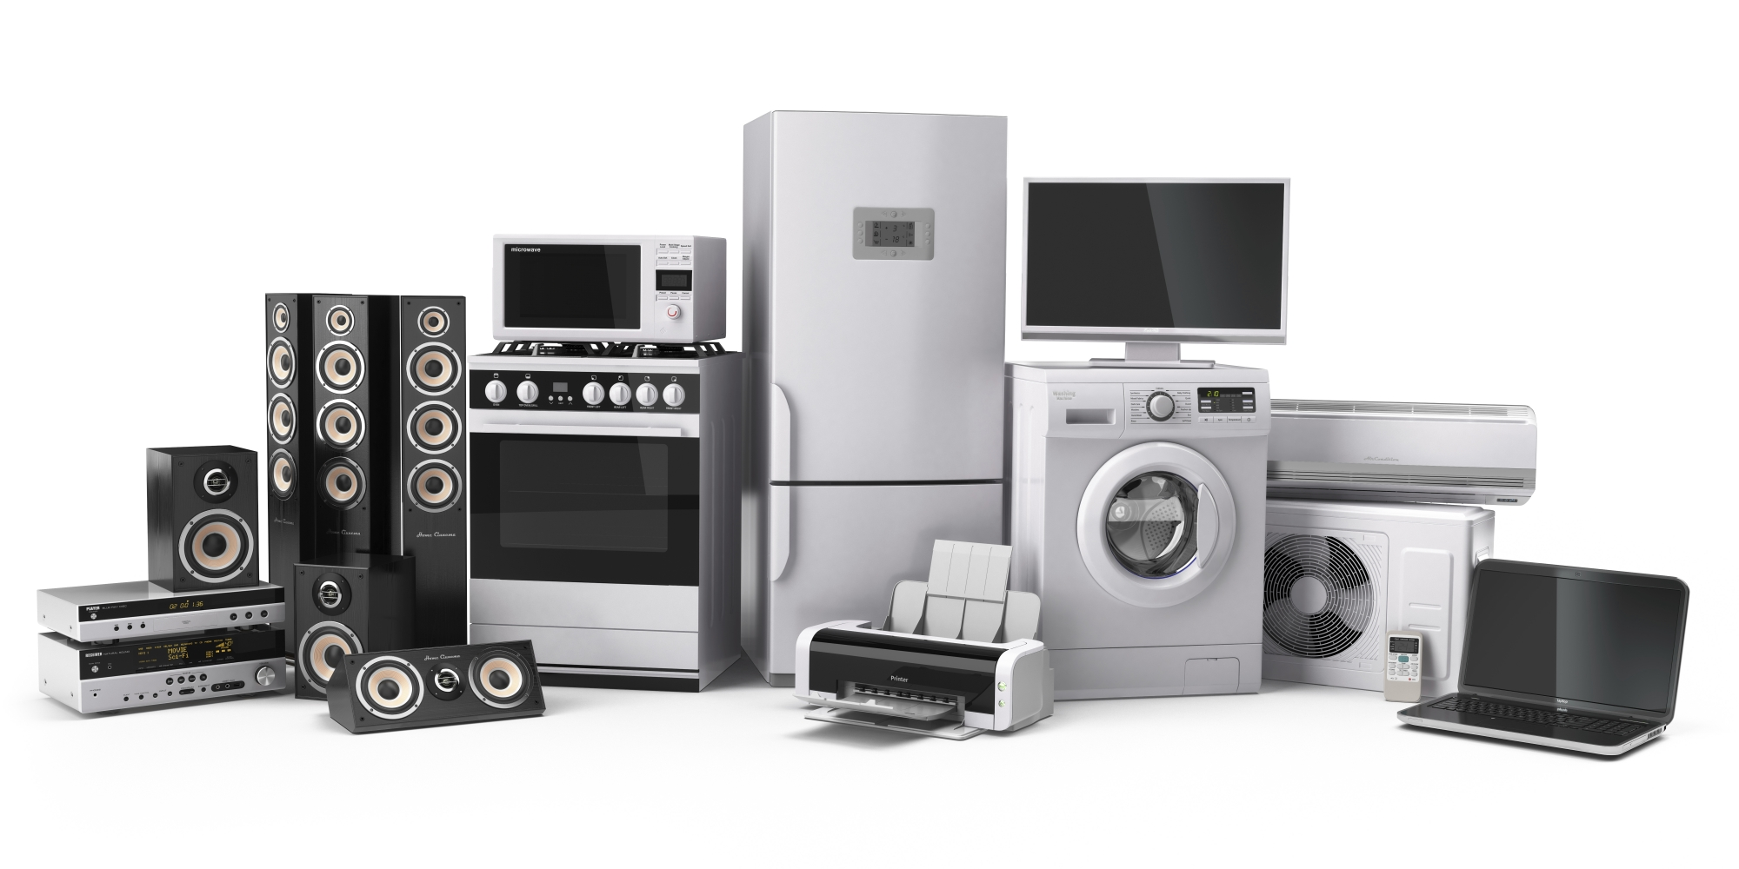

Slide 10
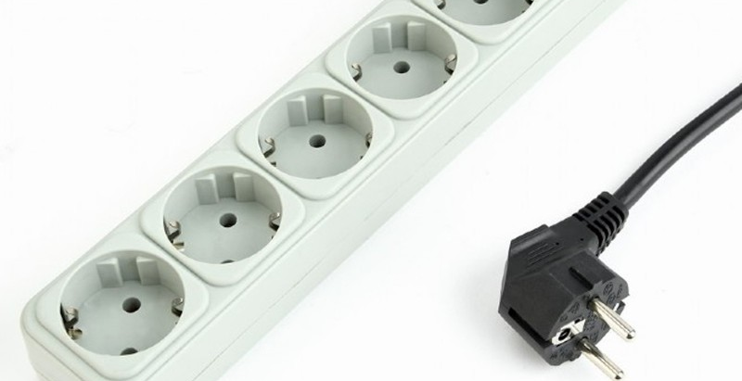

Slide 11
Plugin based solution

Slide 12
Pros

Slide 13
Cons

Slide 14
Demo

Slide 15
Summary

Slide 16


Slide 17

Connect ☺
LinkedIn: https://goo.gl/CRRJ2Y
Mail: martin@sbtech.com
Github: https://github.com/mchaov

